Slide 1
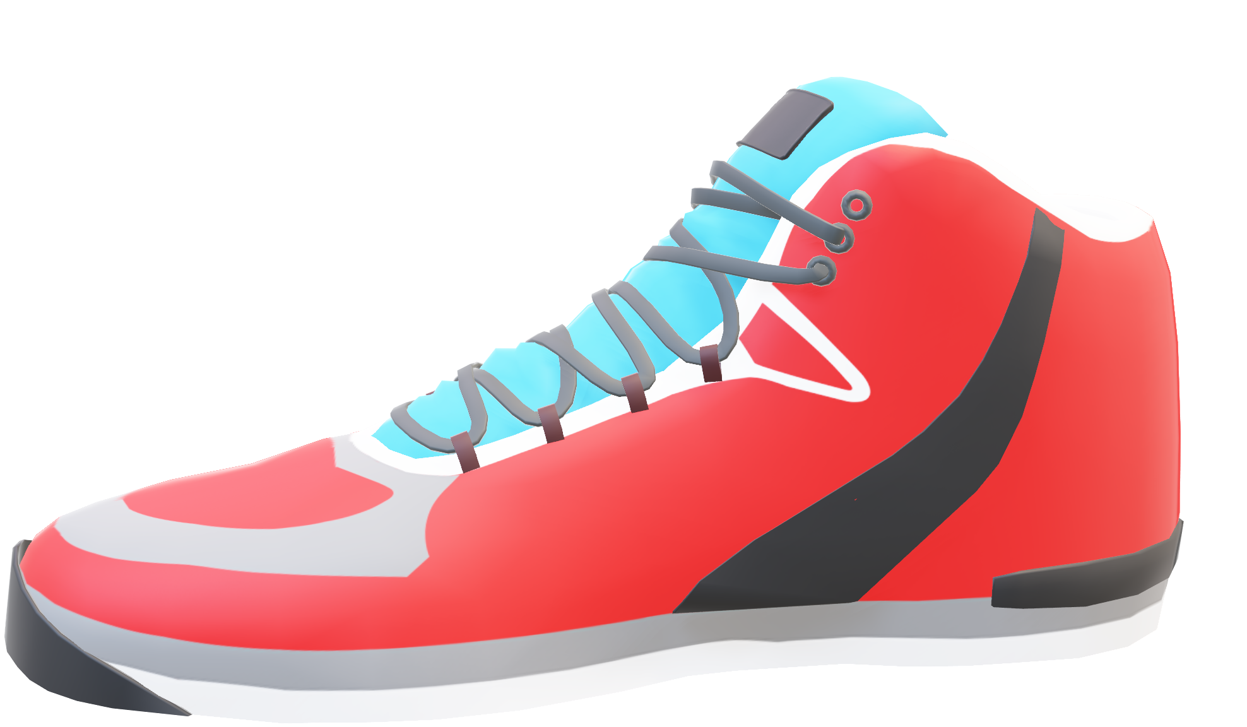
Nike Sportswear
Marketing
Analysis
Archit Navadiya

Slide 2

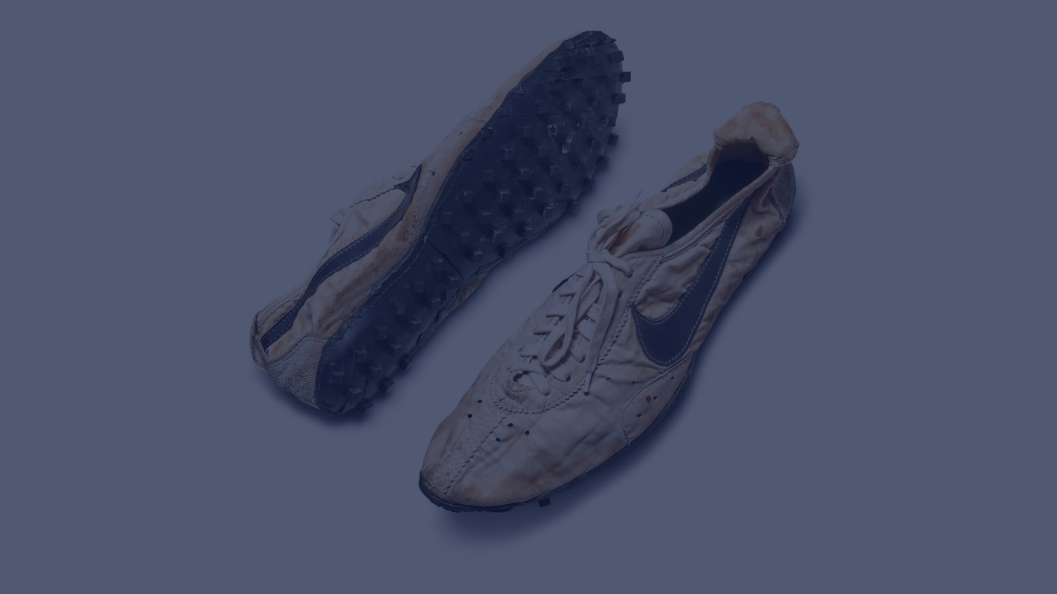
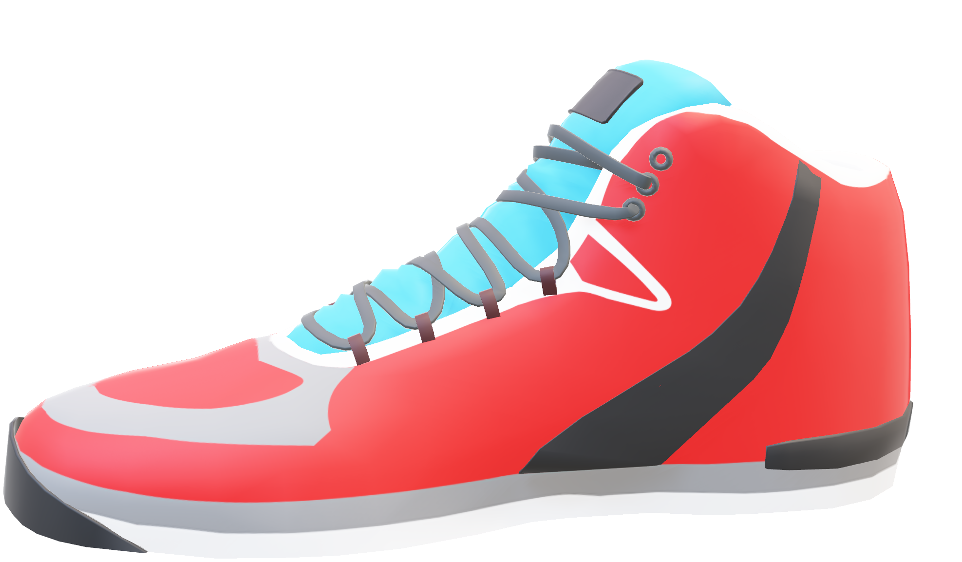
NIKE
HISTORY
JUST DO IT.

Slide 3
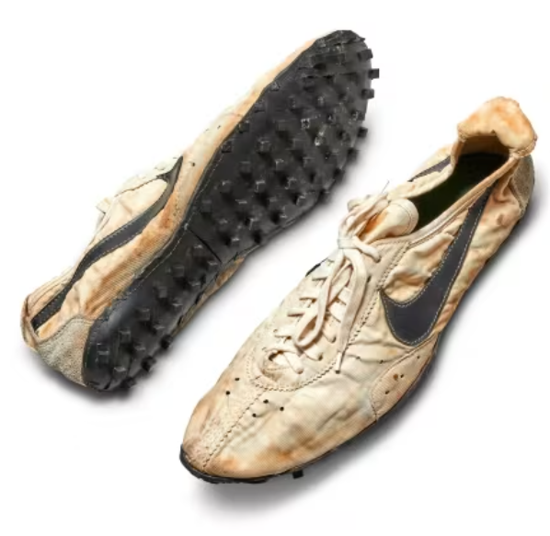

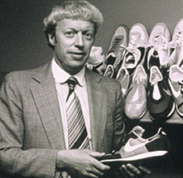


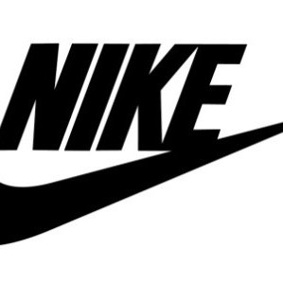
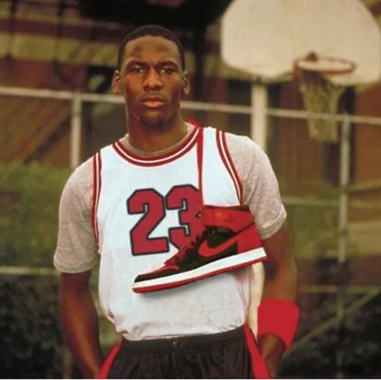

TIMELINE
1972
2003
Bowerman’s breakthrough waffle-soled shoes were invented in 1972.
Acquires Converse for $309 million.
1964
1988
2012
Nike was founded as blue-ribbon sports by Bill Bowerman and Phil Knight.
First “Just Do It” campaign was launched.
Becomes official supplier for NFL apparel.
1971
1984
2015
Officially becomes Nike Inc. Also, the “swoosh” logo was designed in this year.
Nike signs Michael Jordan.
Becomes official supplier for NBA apparel.

Slide 4

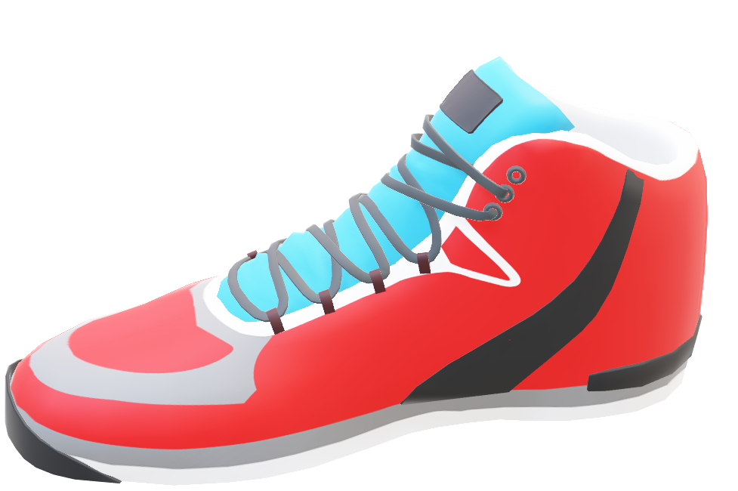
NIKE’s
Marketing Mix
Mission: “To bring inspiration and innovation to every athlete in the world.”
Data
Analysis
Vision: "To remain the most authentic, connected, and distinctive brand."

Slide 5
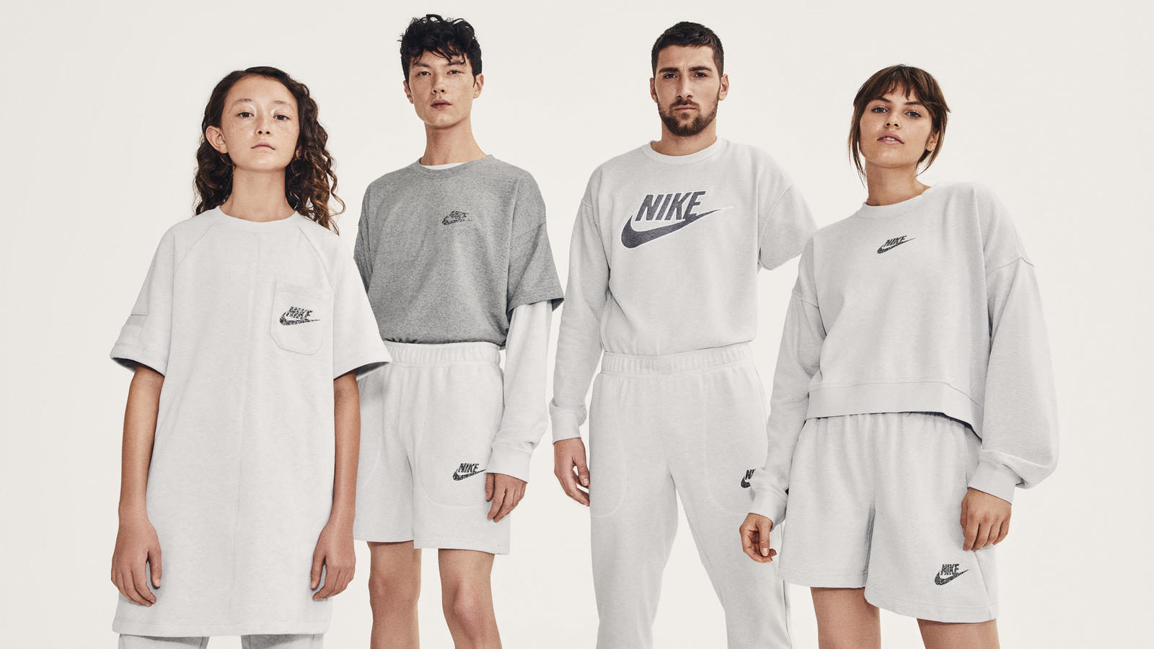




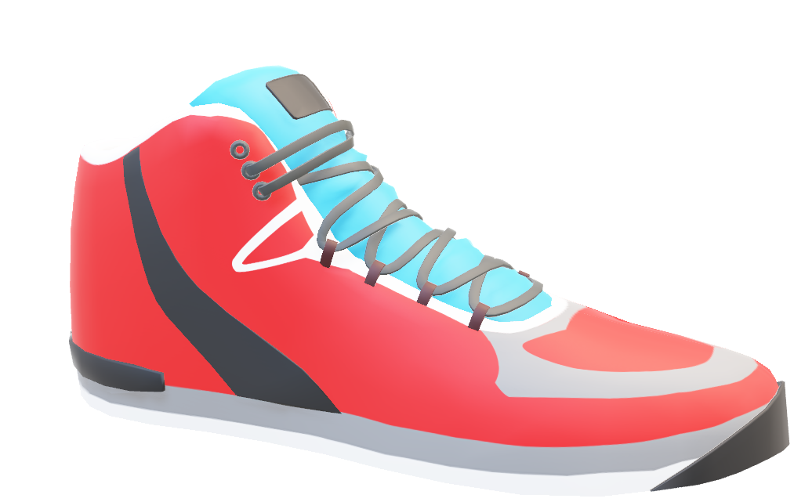
NIKE’s
Marketing Mix
4 P’s
Data
Promotion
-Advertising
-Personal selling
-Sales promotions
-Public relations
Analysis
Product
-Footwear
-Apparel
-Equipment & Accessories
Place
-Retail stores
-Nike Online Store
-Nike retail outlets (company-owned)
Price
-Value-based pricing strategy
-Premium pricing strategy

Slide 6
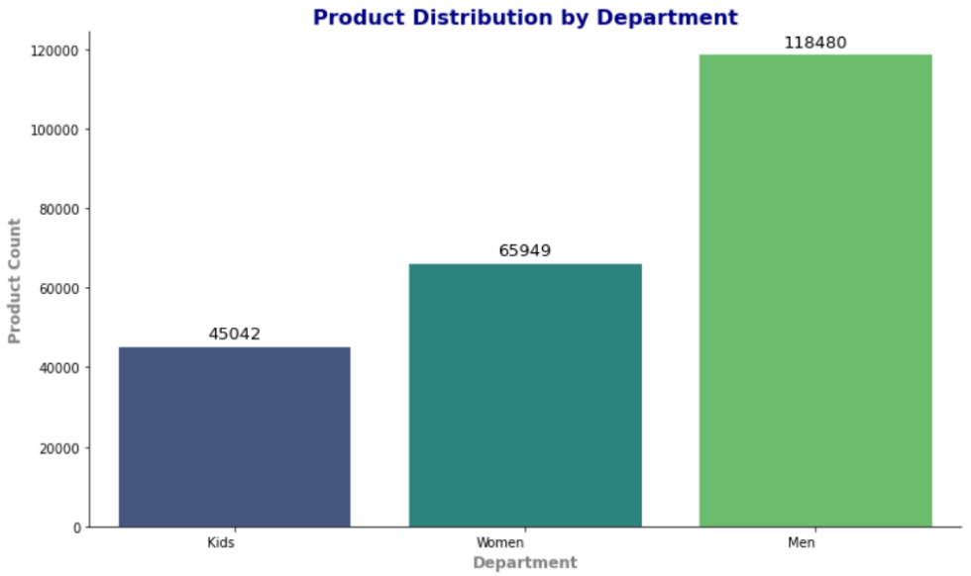



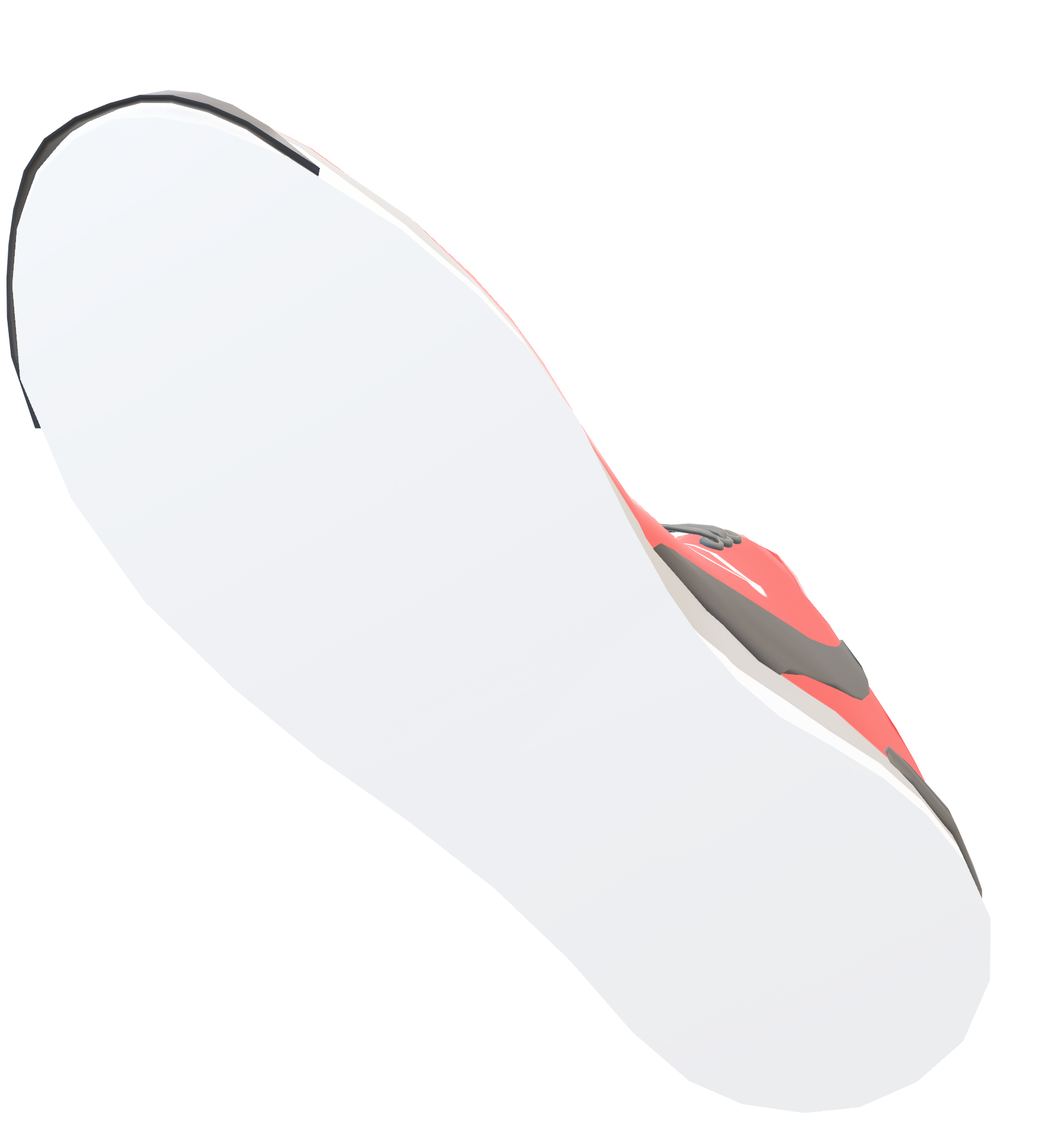
The Men’s department seems to be overstocked. It has almost 2x inventory as compared to Women and 3x the product count in the Kid’s department.
To increase the inventory and sales, it might be helpful to balance the product distribution across the three departments. It might be helpful to conduct market research on the consumer behavior and preferences of the three departments.
The Men’s department seems to be overstocked. It has almost 2x inventory as compared to Women and 3x the product count in the Kid’s department.
To increase the inventory and sales, it might be helpful to balance the product distribution across the three departments. It might be helpful to conduct market research on the consumer behavior and preferences of the three departments.
Data
Analysis

Slide 7




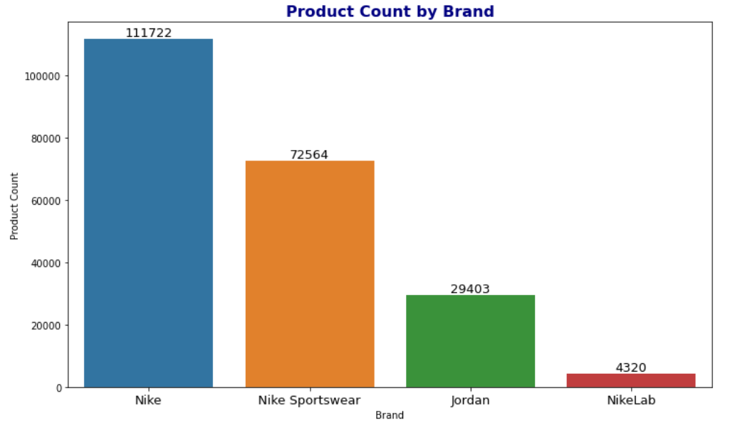


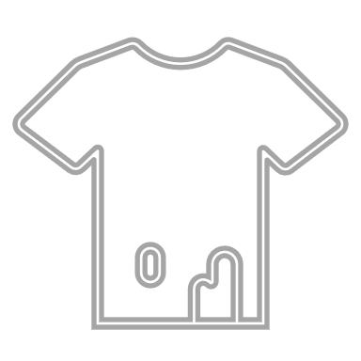


How is the Product Distribution Across Different Departments?
INSIGHT:
The Men’s department seems to be overstocked. It has almost 2x inventory as compared to Women and 3x the product count in the Kid’s department.
INSIGHT:
Nike boasts 111,722 products, with Nike Sportswear at 72,564 and NikeLab with the fewest at 4,320 offerings.
Data Analysis
RECOMMENDATION:
Elevate NikeLab and Jordan visibility via targeted marketing.
Foster appeal through exclusive collaborations.
Drive engagement with limited-edition releases.
RECOMMENDATION:
Conduct consumer behavior analysis for each department. Adjust inventory distribution based on departmental preferences. Implement targeted marketing for each department's specific needs.

Slide 8

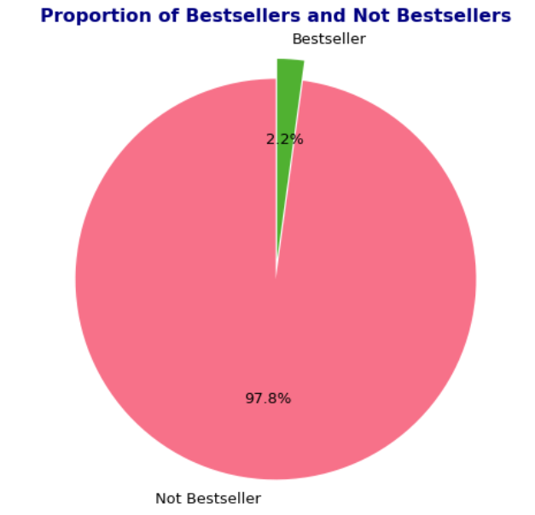

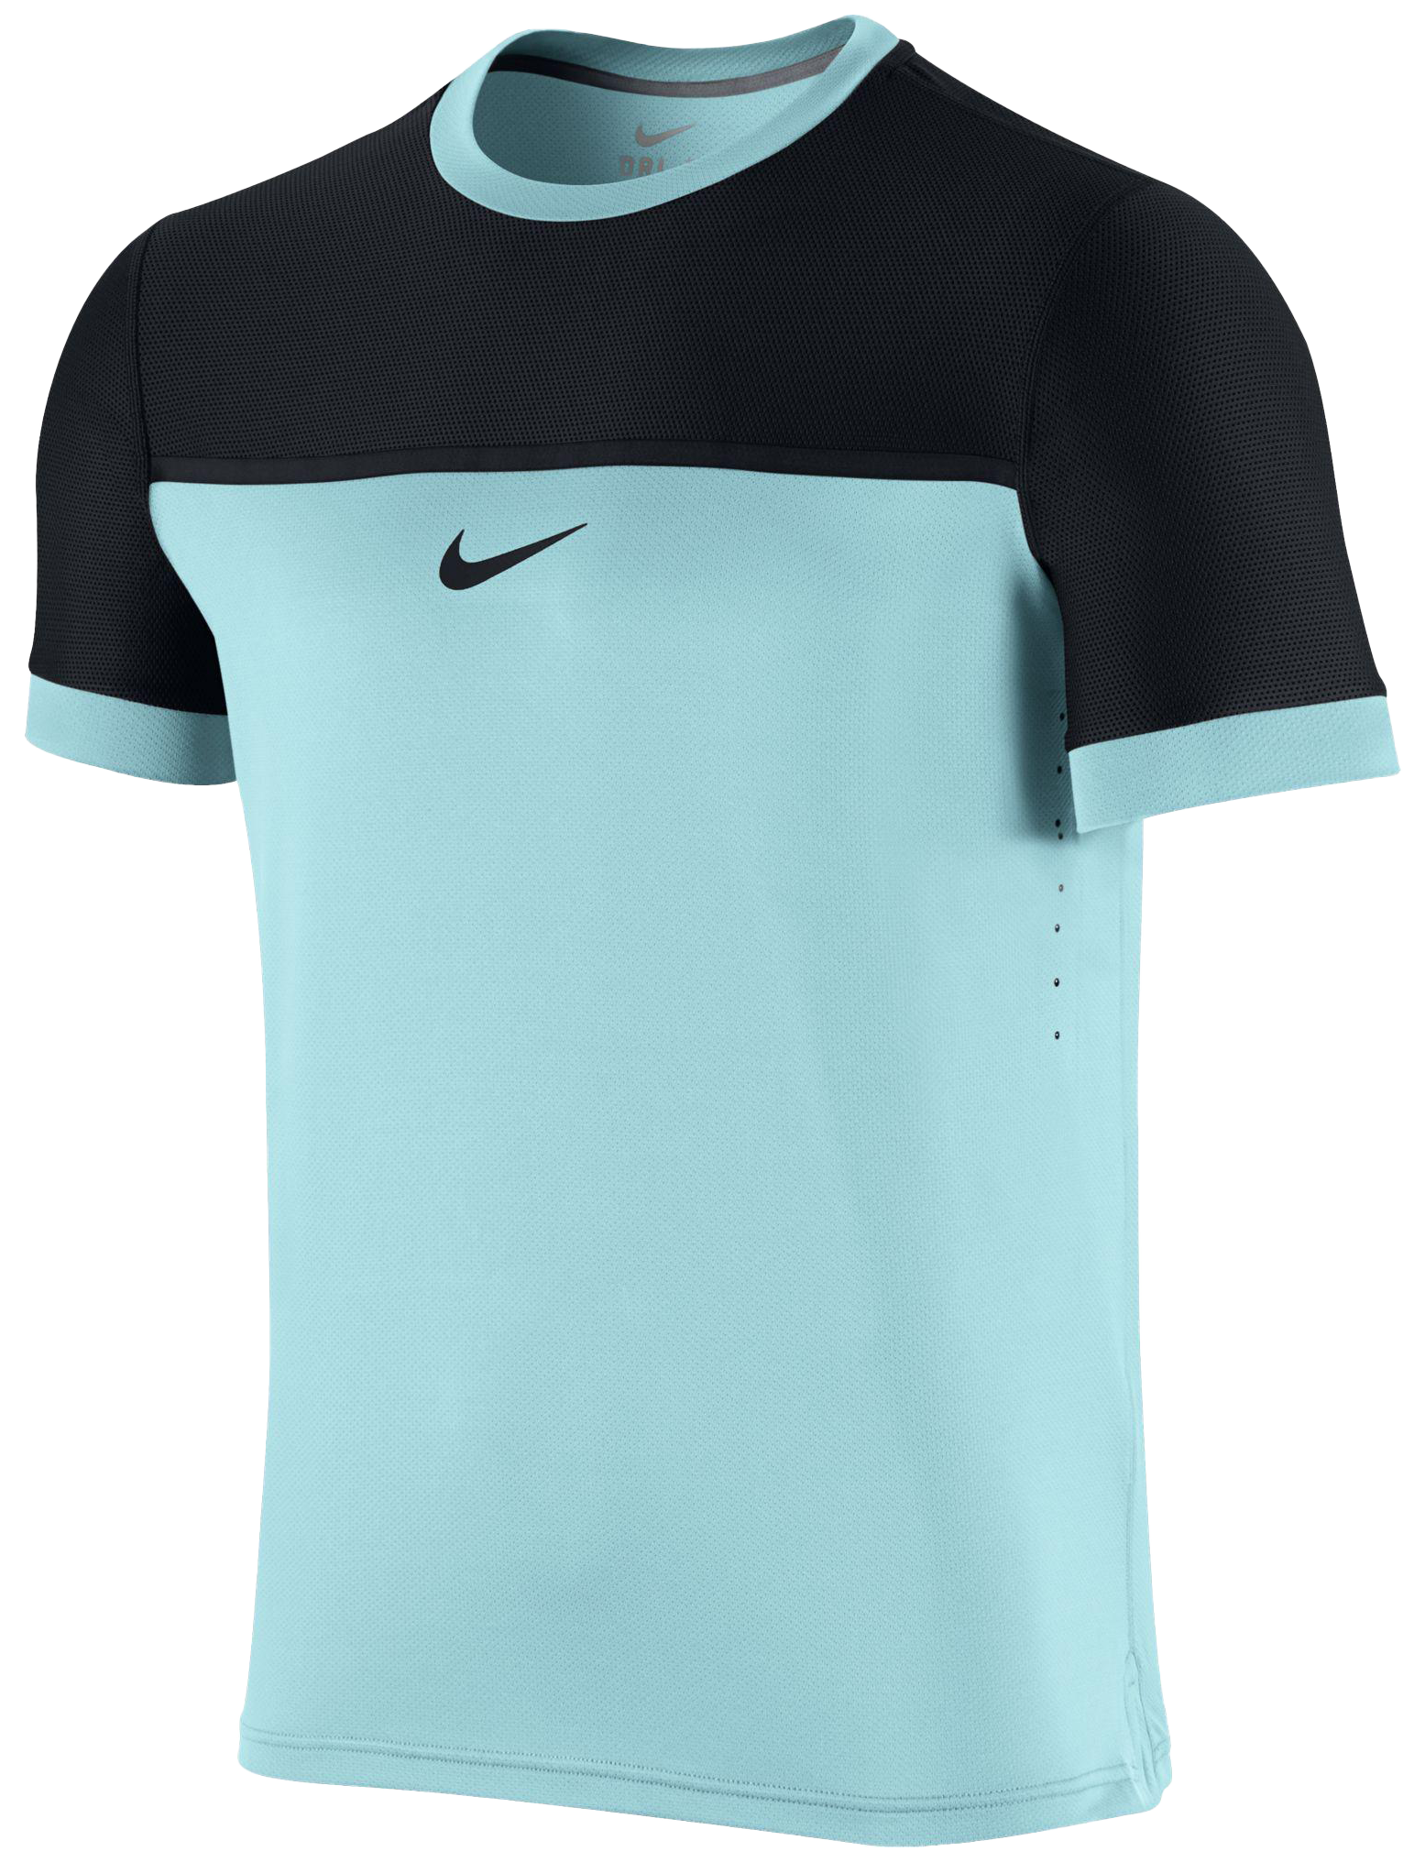
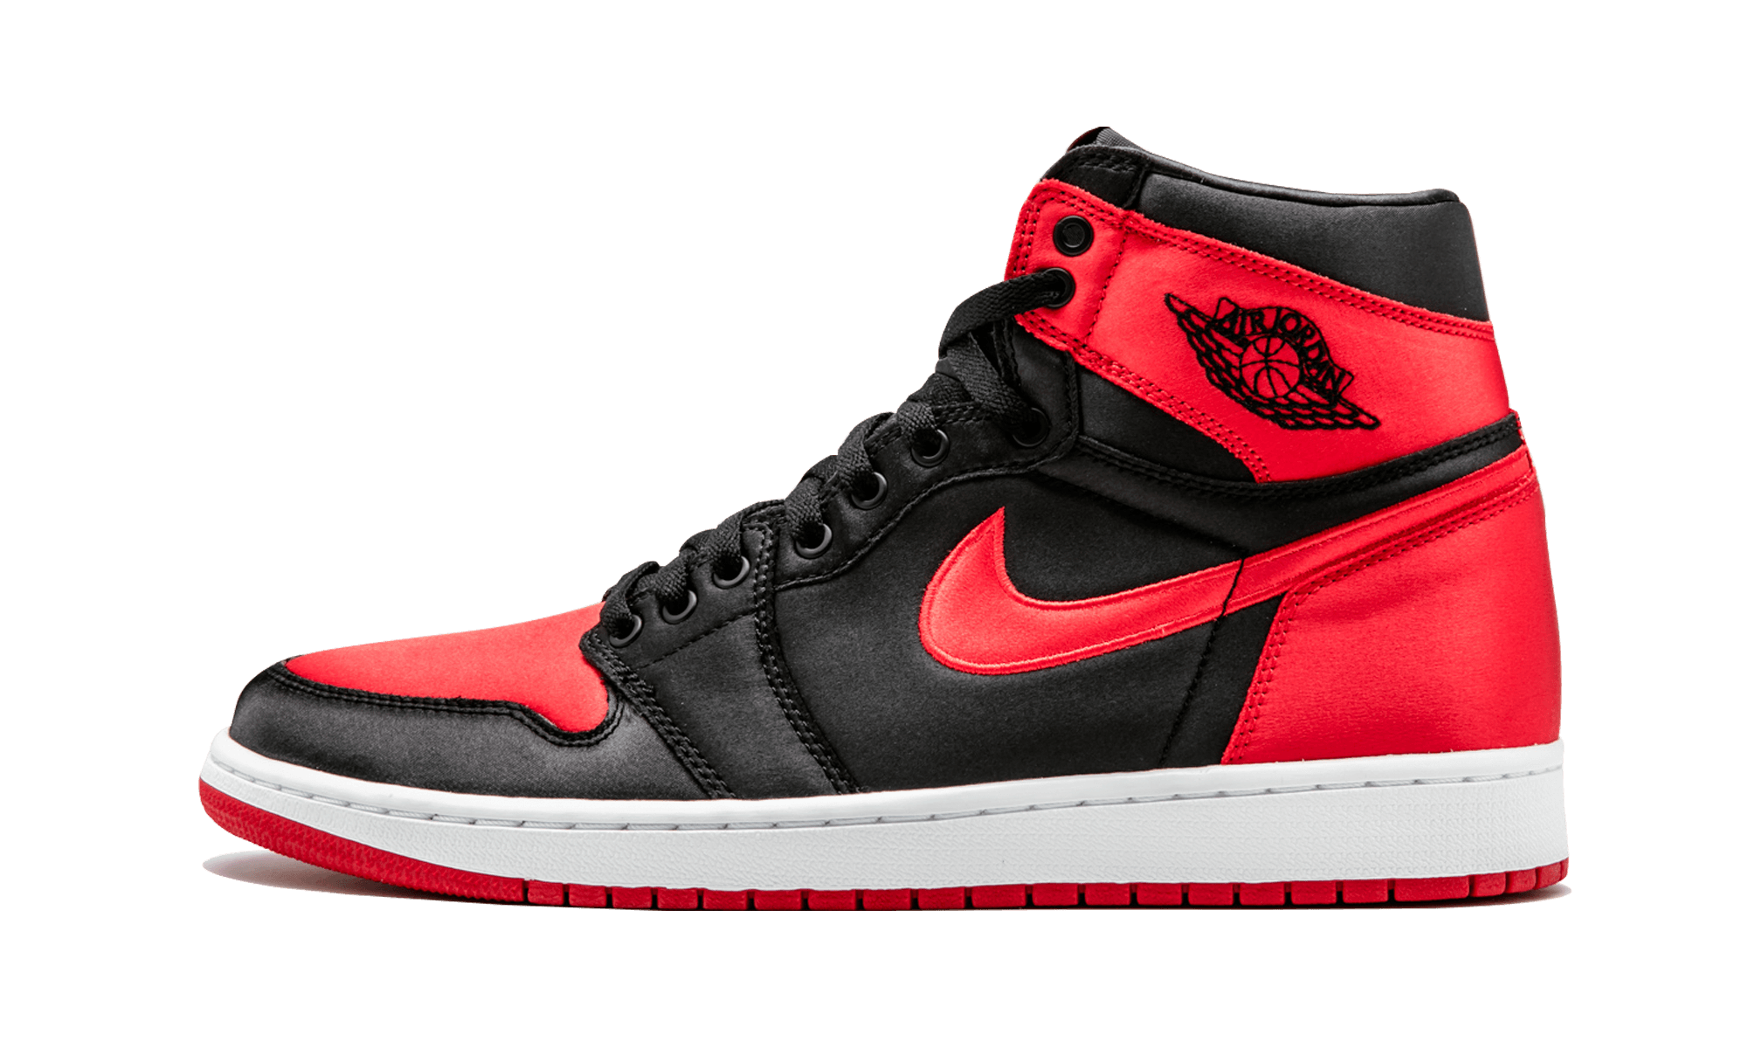
What is the Product Count Across Different Brands?
INSIGHT:
The Men’s department seems to be overstocked. It has almost 2x inventory as compared to Women and 3x the product count in the Kid’s department.
INSIGHT:
Nike boasts 111,722 products, with Nike Sportswear at 72,564 and NikeLab with the fewest at 4,320 offerings.
INSIGHT:
Most of the Nike products, around 97.8%, are categorized as non-bestsellers, with only a small 2.2% classified as bestsellers.
RECOMMENDATION:
Elevate NikeLab and Jordan visibility via targeted marketing.
Foster appeal through exclusive collaborations.
Drive engagement with limited-edition releases.
RECOMMENDATION:
Spotlight unique features of non-bestsellers in marketing.
Cross-promote non-bestsellers with popular products.
Refine non-bestsellers based on feedback for better appeal
RECOMMENDATION:
Conduct consumer behavior analysis for each department. Adjust inventory distribution based on departmental preferences. Implement targeted marketing for each department's specific needs.

Slide 9
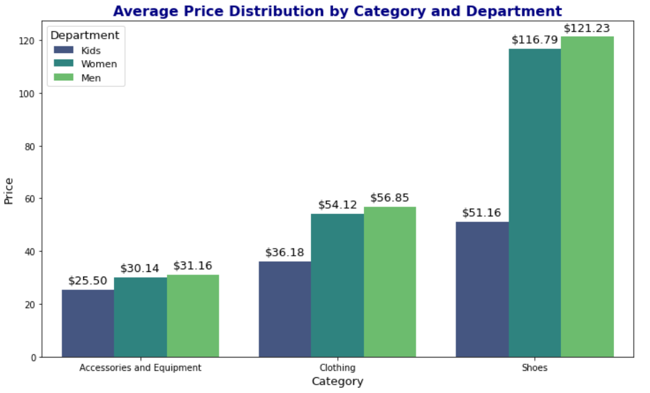
What is the Proportion of Bestsellers to Non-Bestsellers?
INSIGHT:
Nike boasts 111,722 products, with Nike Sportswear at 72,564 and NikeLab with the fewest at 4,320 offerings.
INSIGHT:
Most of the Nike products, around 97.8%, are categorized as non-bestsellers, with only a small 2.2% classified as bestsellers.
RECOMMENDATION:
Elevate NikeLab and Jordan visibility via targeted marketing.
Foster appeal through exclusive collaborations.
Drive engagement with limited-edition releases.
RECOMMENDATION:
Spotlight unique features of non-bestsellers in marketing.
Cross-promote non-bestsellers with popular products.
Refine non-bestsellers based on feedback for better appeal

Slide 10
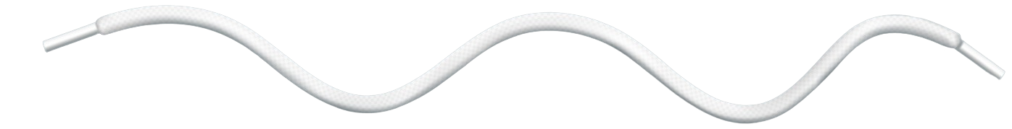


What is the Average Price Distribution for Different Categories and Departments?
INSIGHT:
Shoes have the highest average price, led by Men’s average shoes price at $121.23, followed by Women's at $116.79, and Kids' at $51.16.
INSIGHT:
Most of the Nike products, around 97.8%, are categorized as non-bestsellers, with only a small 2.2% classified as bestsellers.
RECOMMENDATION:
Spotlight unique features of non-bestsellers in marketing.
Cross-promote non-bestsellers with popular products.
Refine non-bestsellers based on feedback for better appeal
RECOMMENDATION:
Highlight unique features of other categories in targeted ads.
Offer personalized recommendations for diverse category purchases.
Create themed bundles across categories for cross-promotion.

Slide 11
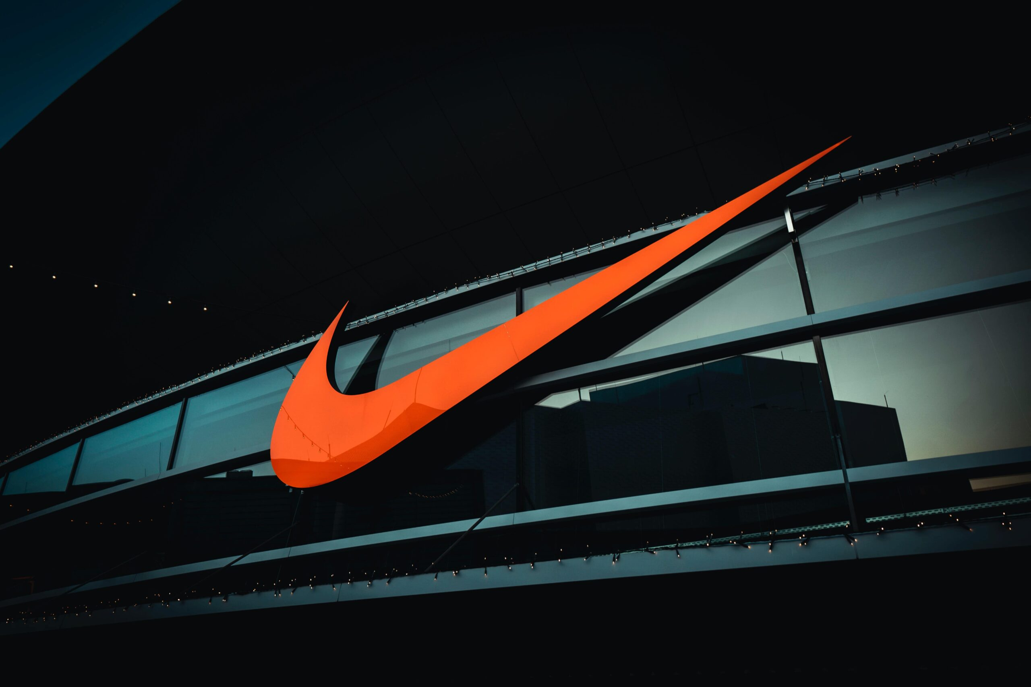

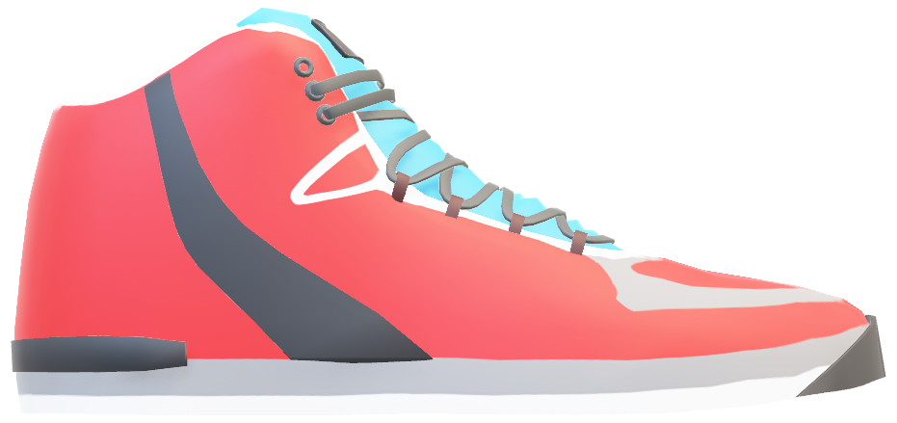

Marketing Strategies
SWOT Analysis
Strength
Strong Brand Equity
Enormous Market Share
Innovative Marketing
Celebrity Endorsements
Successful Sub-Brands
High Market Valuation
Weakness
Labor Practice Criticism
Over-Dependence on U.S. Market
Unfavourable Retailer Relationships
Footwear-Centric Revenue
Opportunity
New Markets
Product Range Expansion
Future Trends
Anti-Counterfeiting Measures
Sustainability Initiatives
Threat
Counterfeit Products
Competition
Animal Abuse Scandals
Competitors' Advertising Investments

Slide 12
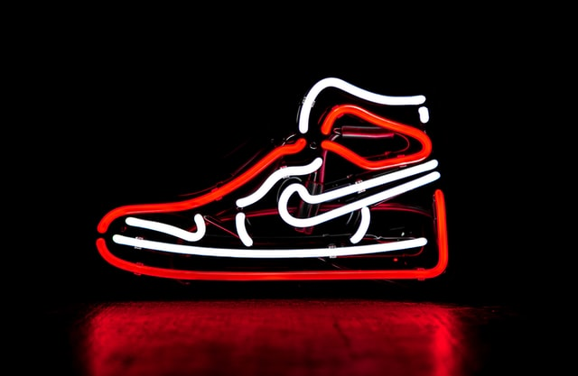
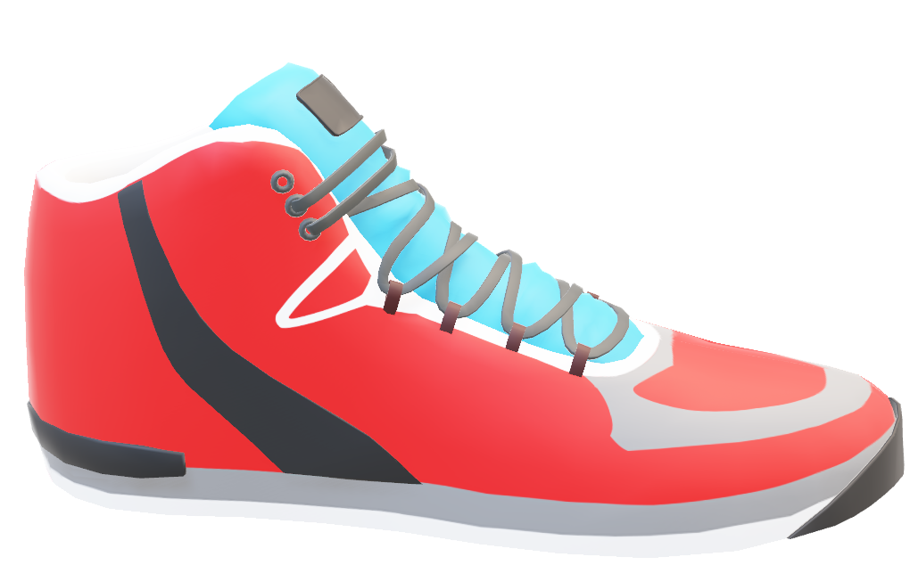
Marketing Strategies
SWOT Analysis
Target audience segmentation
Nike caters to athletes, fitness enthusiasts, and fashion-conscious consumers with tailored products and marketing.
Not overselling the products
Nike prioritizes quality, ensuring each product release innovates in performance and style, avoiding oversaturation pitfalls.
A focus on pain points
Nike innovates products, enhancing performance, comfort, and style to address consumer needs in athletic and lifestyle markets.
Emotional marketing
Nike's marketing inspires and empowers consumers emotionally, reaching beyond sports through powerful campaigns.
Working with celebrities and influencers
Nike builds credibility by partnering with top athletes, celebrities, and influencers, aligning its brand with excellence and cultural influence.

Slide 13
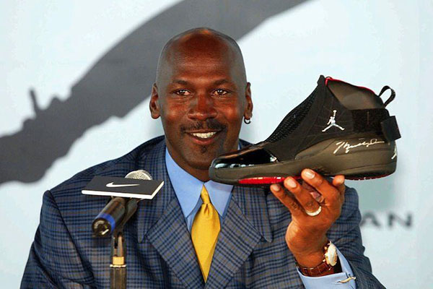
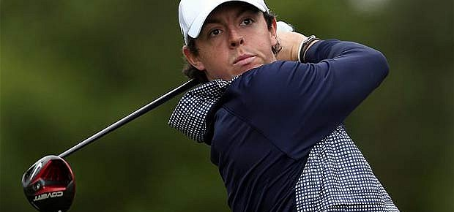
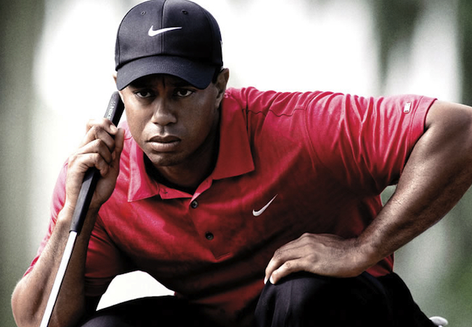
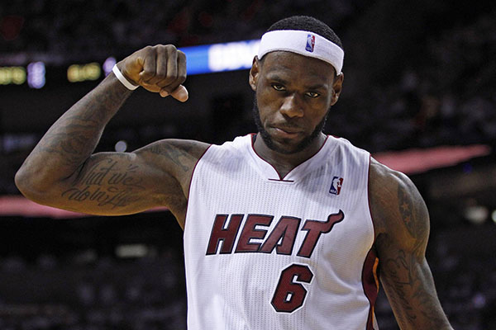
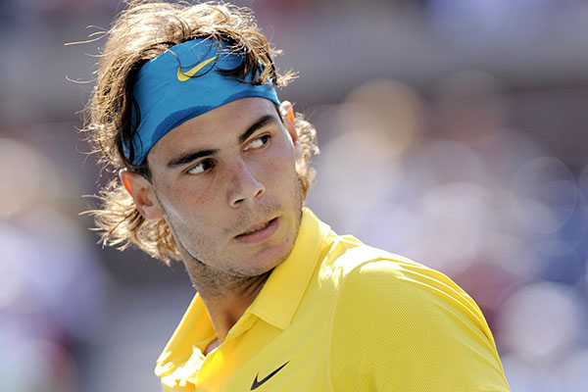
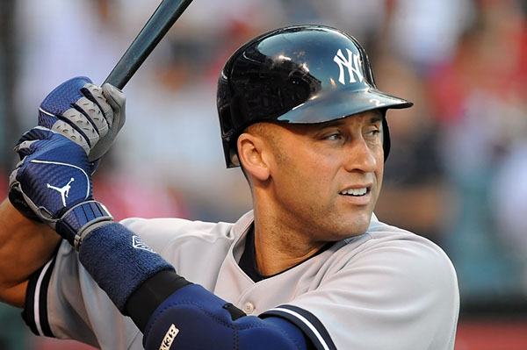
COMPETITION
ENDORSEMENTS
Nike endorsements refer to partnerships or sponsorships between Nike and athletes, teams, or other public figures. Nike has a long history of collaborating with high-profile athletes, such as Michael Jordan, LeBron James, and Tiger Woods, to promote its products and build its brand
MICHAEL JORDAN
RORY MCILROY
TIGER WOODS
LEBRON JAMES
RAFAEL NADAL
DEREK JETER

Slide 14

COMPETITION
ENDORSEMENTS
Adidas is a multinational corporation that designs and manufactures athletic and casual footwear, apparel and accessories, and is the largest sportswear manufacturer in Europe. Adidas stands at #58 globally having net worth of $38.18B.
Puma is ranked #63 with net worth of $9.26B. It is a German multinational company that designs and manufactures athletic and casual footwear, apparel and accessories, and is the third-largest sportswear manufacturer in the world.
Under Armour is worth $5.9B and is ranked #231. Under Armour is an American company that produces athletic apparel, footwear, and accessories and is known for its innovative performance materials and designs.
Sketchers is an American footwear company that produces lifestyle and performance shoes for men, women, and children, and is known for its casual and comfortable styles. Skechers has market cap of $8.6B and is ranked #194.

Slide 15
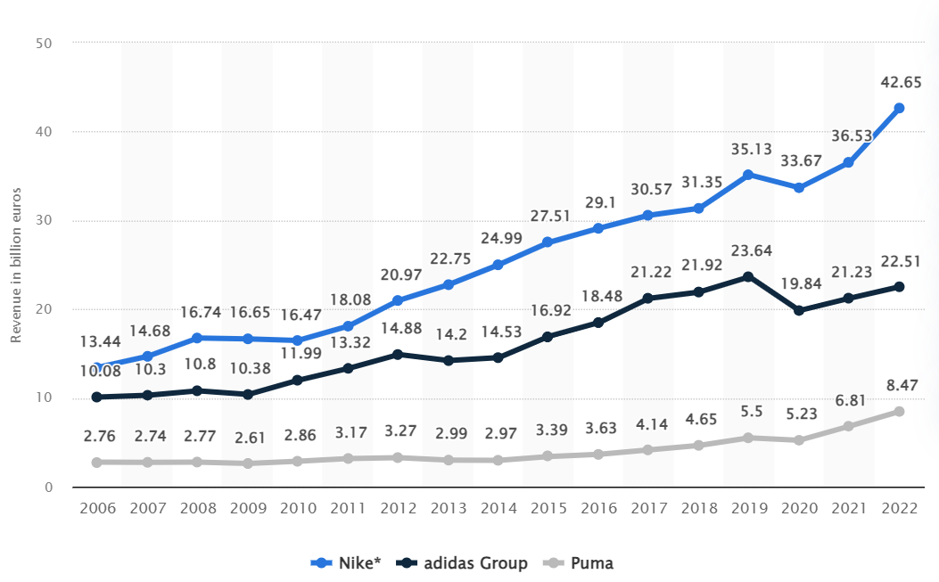
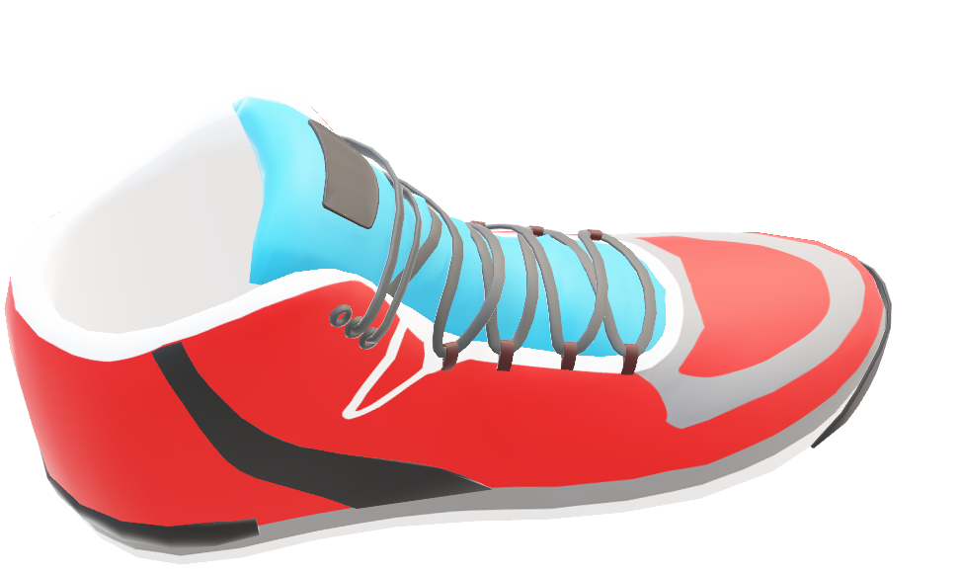
COMPETITION
ENDORSEMENTS
Global revenue of adidas, Nike and Puma
Nike has generated 217% more revenue since 2006 as compared to Adidas and Puma that have generated 122% and 206% respectively since 2006. All three companies have shown a steady increase in revenue over the years. Nike has maintained a significant lead over the other two throughout this period.

Slide 16

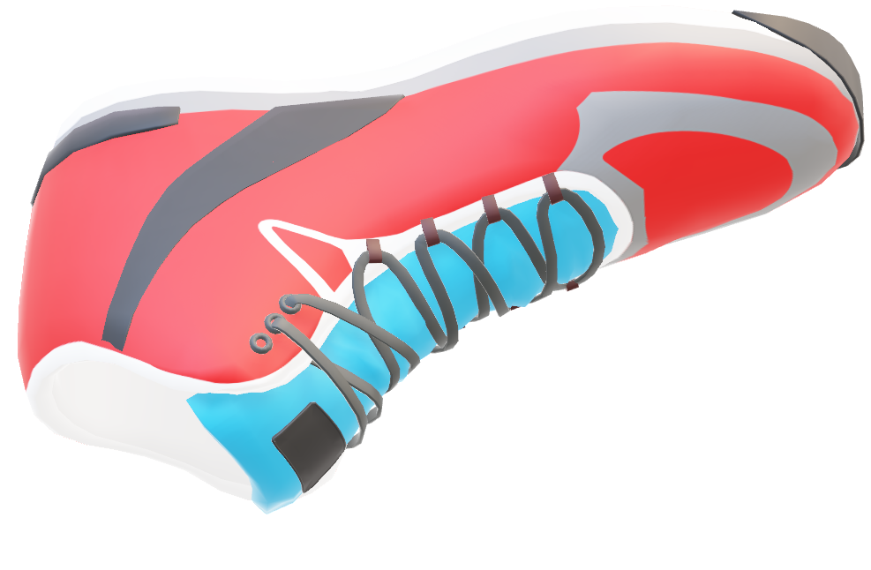
STATISTICS
TOTAL REVENUE
IN 2023
TOTAL STORES
IN 2023
OVERALL NPS SCORE AS OF 2022
$51.22B
1,032
50 %
Total revenue generated by Nike as of 2023 increased to $51.2B as compared to the revenue generated in the year 2005 which was $13.74B.
In the year of 2009, Nike had 674 stores worldwide and the highest were in 2018 with 1,182 stores. In 2023, Nike has 1,032 stores worldwide.
65% percent of the Nike’s customers are Promoters, 20% are Passives, and 15% are Detractors, totaling up to 50% NPS score.

Slide 17

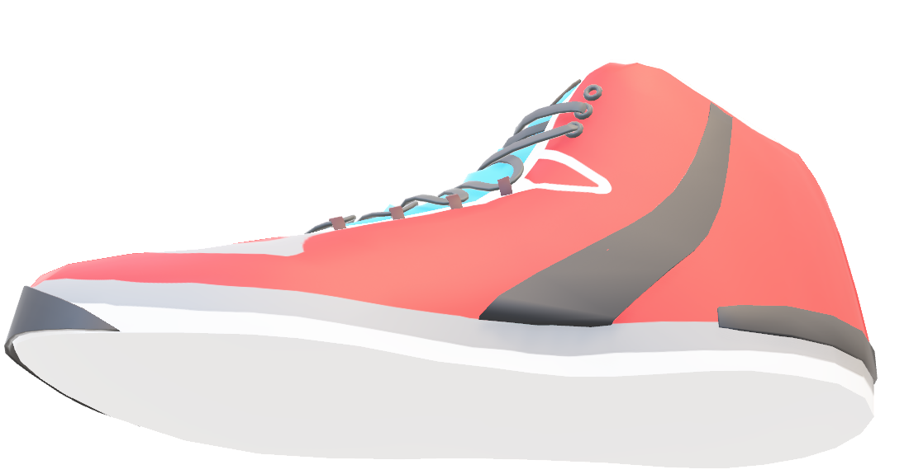
RECOMMENDATION
Nike should use augmented reality (AR) and virtual reality (VR) technologies to give customers unique shopping experiences, including virtual try-ons or immersive brand experiences.
Nike already has a significant online presence, but expanding its direct-to-consumer channels might strengthen relationships with customers and boost revenue. This can include first access to new products or customized online or mobile purchasing experiences.
By leveraging customer data such has search habit, Nike could offer more personalized product recommendations and marketing messages. This can lead to higher customer engagement
Although Nike is a worldwide brand, it may increase sales by adapting its business practices according to local preferences and tastes in different markets. This may involve local collaborations or targeted advertising initiatives.

Slide 18
REFERENCES
https://www.kaggle.com/datasets/polartech/nike-sportwear-product-dataset
https://www.kaggle.com/datasets/tinkuzp23/nike-onlinestore-customer-reviews
https://www.google.com/url?sa=i&url=https%3A%2F%2Fwww.slideserve.com%2Ferma%2Fnike&psig=AOvVaw18OO3GmuZxXNzVv42vwkv8&ust=1700848152488000&source=images&cd=vfe&opi=89978449&ved=0CBIQjRxqFwoTCKDdxKHX2oIDFQAAAAAdAAAAABAE
https://panmore.com/nike-inc-vision-statement-mission-statement
https://penji.co/nike-marketing-strategy/
https://panmore.com/nike-inc-marketing-mix-4ps-product-place-promotion-price-analysis
https://www.statista.com/statistics/269599/net-sales-of-adidas-and-puma-worldwide/
https://www.statista.com/statistics/241683/nikes-sales-worldwide-since-2004/
https://www.comparably.com/brands/nike
https://www.statista.com/statistics/250287/total-number-of-nike-retail-stores-worldwide/#:~:text=Number%20of%20Nike%20stores%20globally%202009%2D2023&text=As%20of%20May%2031%2C%202023,nearly%20370%20in%20that%20year.
https://ca.trustpilot.com/review/nike.uk
https://slidechef.net/templates/free-animated-nike-template/
https://en.wikipedia.org/

Slide 19
THANK YOU

